Slide 1
Data on HEInnovate use
(2013-2023)
UBC: preparing the EU talents for the future
2nd Education and Innovation Summit
Brussels, 27 June 2023

Slide 2

User registrations
Number of new user registrations by year (total users: 30,166)
Notes:
Peaks in 2016: Romanian exercise; 2018: country reviews; 2021: EIT HEI Initiative

Slide 3
User registrations
 | 2014 | 2015 | 2016 | 2017 | 2018 | 2019 | 2020 | 2021 | 2022 | 2023 | Total
New Users | 2,836 | 2,528 | 7,735 | 2,368 | 3,860 | 1,028 | 2,255 | 4,203 | 2,208 | 1,148 | 30,166
% of total users | 9.4% | 8.4% | 25.6% | 7.8% | 12.8% | 3.4% | 7.5% | 13.9% | 7.3% | 3.8% | 100%
Number of new user registrations by year (total users: 30,166)

Slide 4
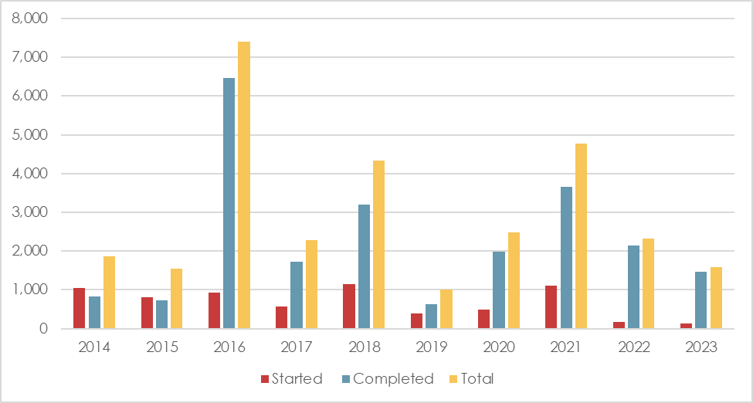
Total number of self-assessments
Self-assessments – by stage of progress and year
Notes:
Completed = filled in and submitted

Slide 5
Total number of self-assessments
Self-assessments – by stage of progress and year

Slide 6
Number of self-assessments by dimension
Notes:
« Digital Transformation and Capability » was only added in 2018

Slide 7
Number of submitted self-assessments by EU MS
Romania is not included in the chart as it has over 7.5k submissions

Slide 8
Number of self-assessments by non-EU country
Top 10

Slide 9
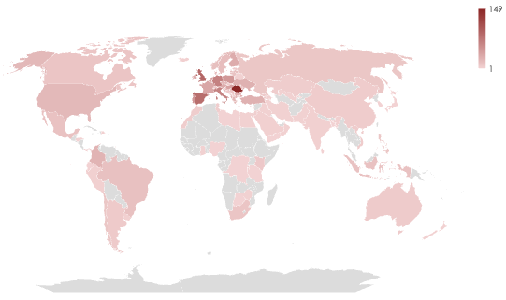
Number of HEIs with self-assessment submission by country

Slide 10
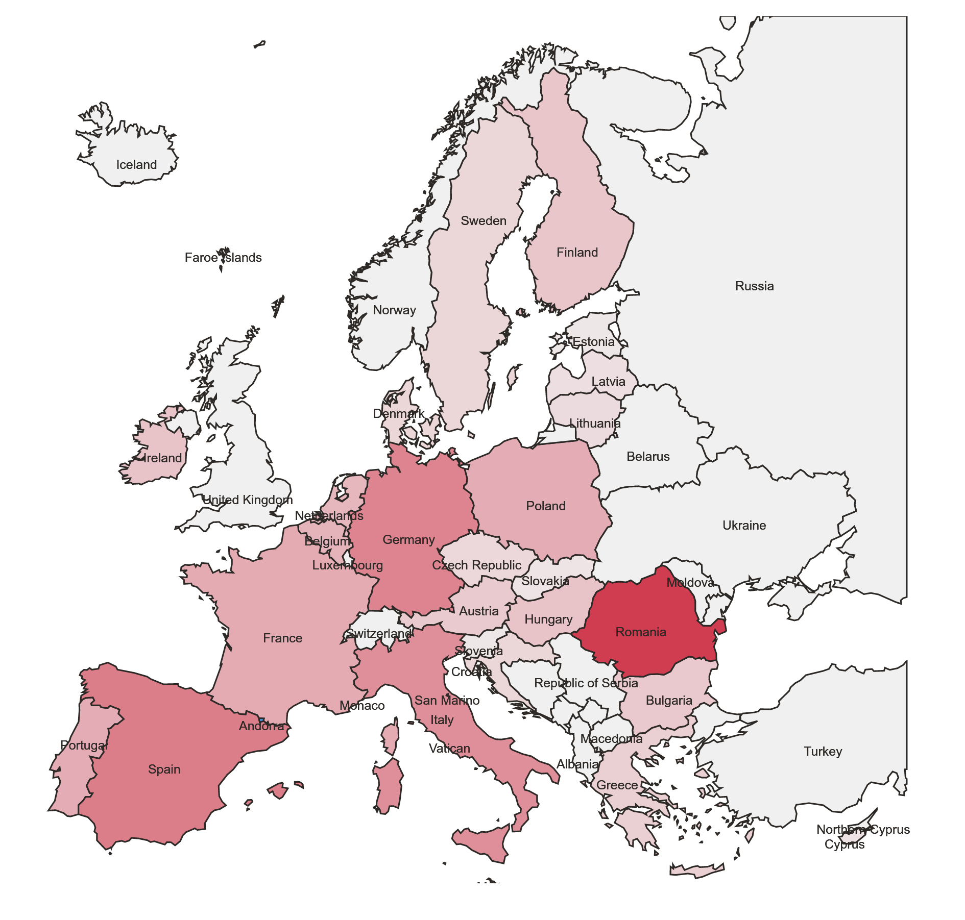

Number of HEIs with self-assessment submission by EU MS

Slide 11
Number of HEIs with self-assessment submission by EU MS
Total number of HEIs submitting the self-assessment in EU27: 1,087

Slide 12
Number of HEIs with self-assessment submission by EU MS
Top 10 EU27
Ranking | Country | Number of HEIs | HEIs per country as percentage of total EU27 HEIs
1 | Romania | 149 | 15.8%
2 | Spain | 83 | 8.8%
3 | Germany | 66 | 7.0%
4 | Italy | 65 | 6.9%
5 | Portugal | 49 | 5.2%
6 | Poland | 47 | 5.0%
7 | Netherlands | 43 | 4.6%
8 | Belgium | 40 | 4.3%
9 | Hungary | 40 | 4.3%
10 | France | 35 | 3,7%
Total number of HEIs submitting the self-assessment: 1,087

Slide 13
Number of HEIs with self-assessment submission by non-EU country
Top 10 non-EU countries

Slide 14

Make your self-assessment at https://heinnovate.eu/en
© European Union 2023
Reuse of this presentation authorised under the CC BY 4.0 license.
Notes:
Update/add/delete parts of the copy right notice where appropriate.
More information: https://myintracomm.ec.europa.eu/corp/intellectual-property/Documents/2019_Reuse-guidelines%28CC-BY%29.pdf

